Slide 1


Slide 2
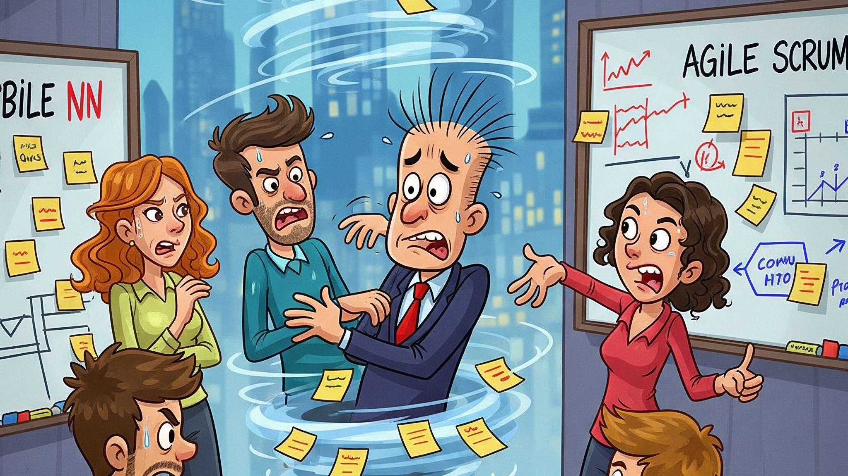

Slide 3


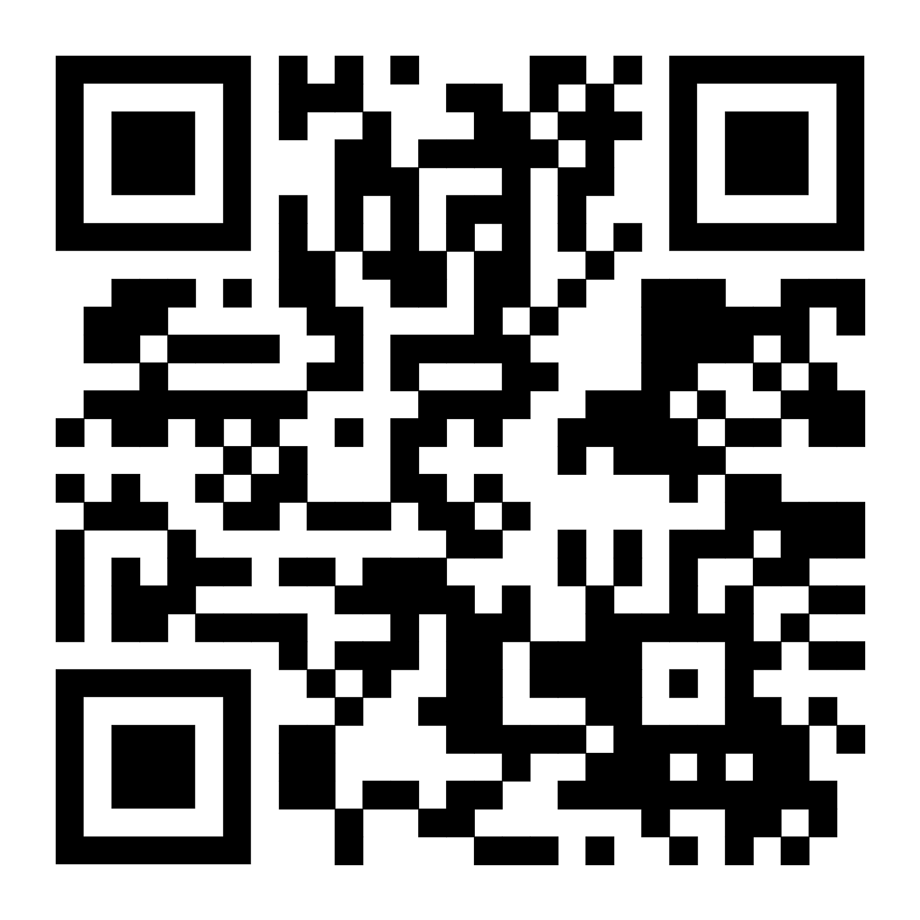
Join the game and provide your feedback now!

Slide 4
Demo

Slide 5

A whole new world of agile efficiency
Agile teams save $65K per year with Task Genie

Slide 6


